Slide 1
Regression Methods-Loans Data Project
4/29/20
-Team GLM. Haichuan Du. Adhiraj Roka

Slide 2
Introduction
Loans dataset from Kaggle.
Model how many days an individual has to pay back a loan
Important because it tells us how quickly or how long it would take a person to finish paying off a loan,
can use the information to better utilize terms for quicker liquidity turn around.
can we model whether a loan would be paid by the due date using a logistic regression model.
useful to predict which individuals will default on loans and minimize risk.

Slide 3
Data Preparation
Response variable: Paid off time - Effective Date=> loan length
Predictors: Loan_status: Whether a loan is paid off, in collection, collection paid off Principal: Basic principal loan amount Terms: weekly (7 days), biweekly, and monthly payoff schedule Effective_date, Due_date, Paidoff_time , Age, education, gender Pastdue_days: How many days a loan has been past due
Education levels were fixed, Past_due days NA’s were there for those who already paid before due date, so converted to 0.
Subset only collection paid off and paid off as we’re modeling how many days an individual has to pay back a loan otherwise number of days is indefinite.

Slide 4
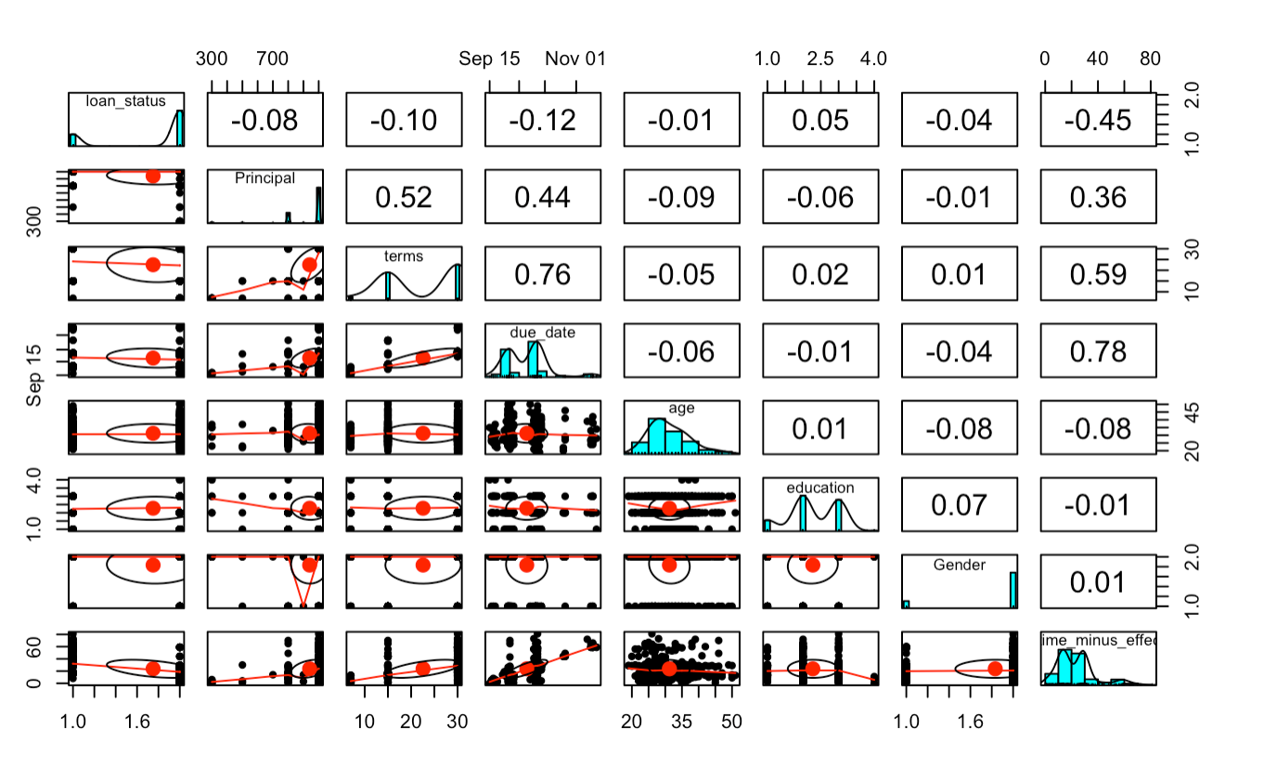
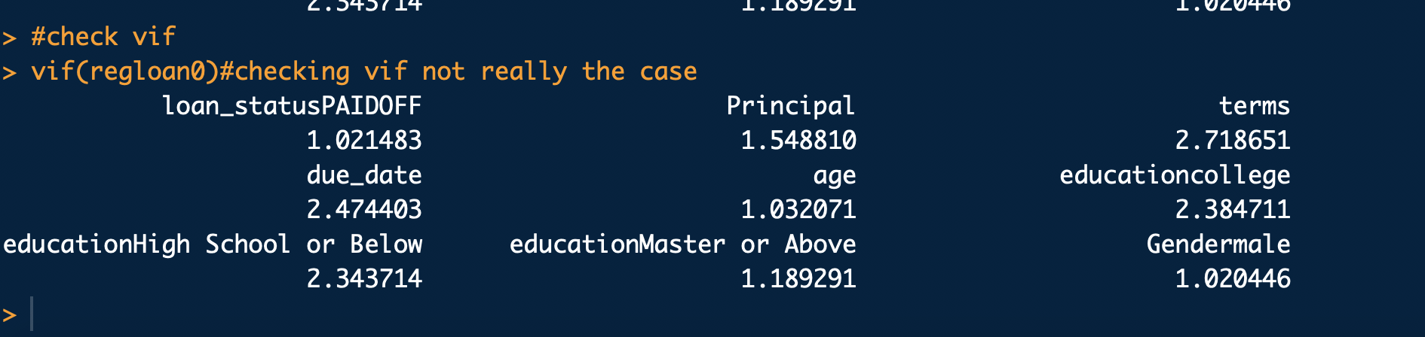
Model Formulation
Looks like there might be some
multicollinearity issues between
terms, principal and due date
Check VIFs (<5)
Drop past-due-days essentially gives same
information as response.

Slide 5
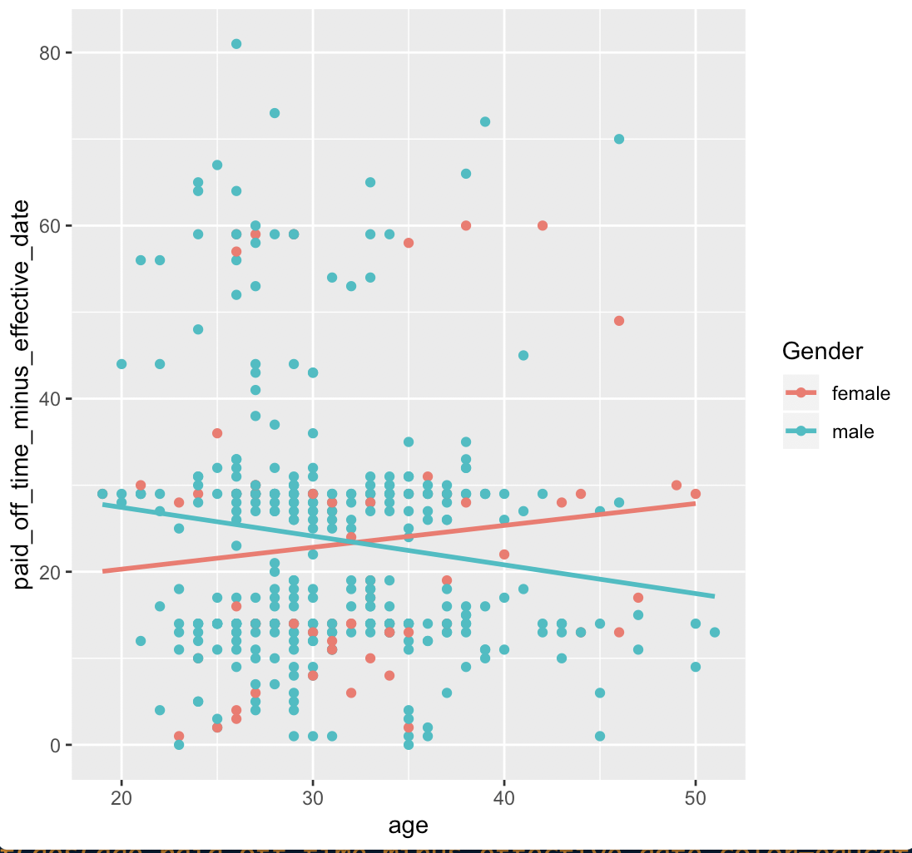
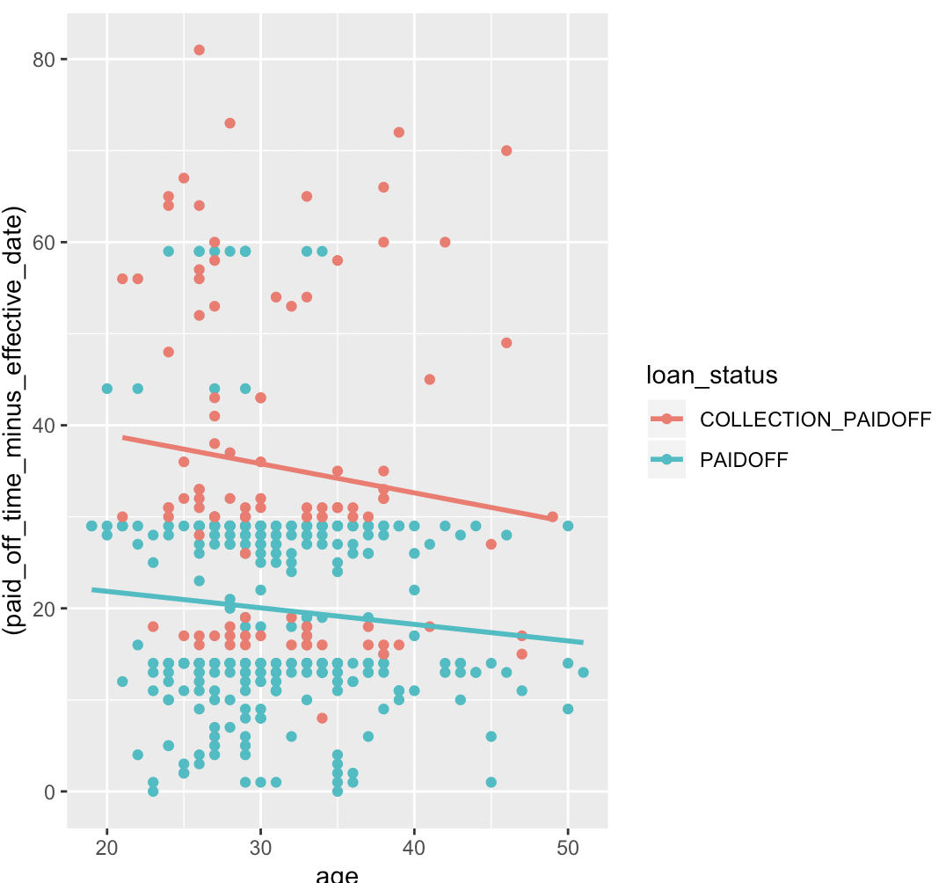
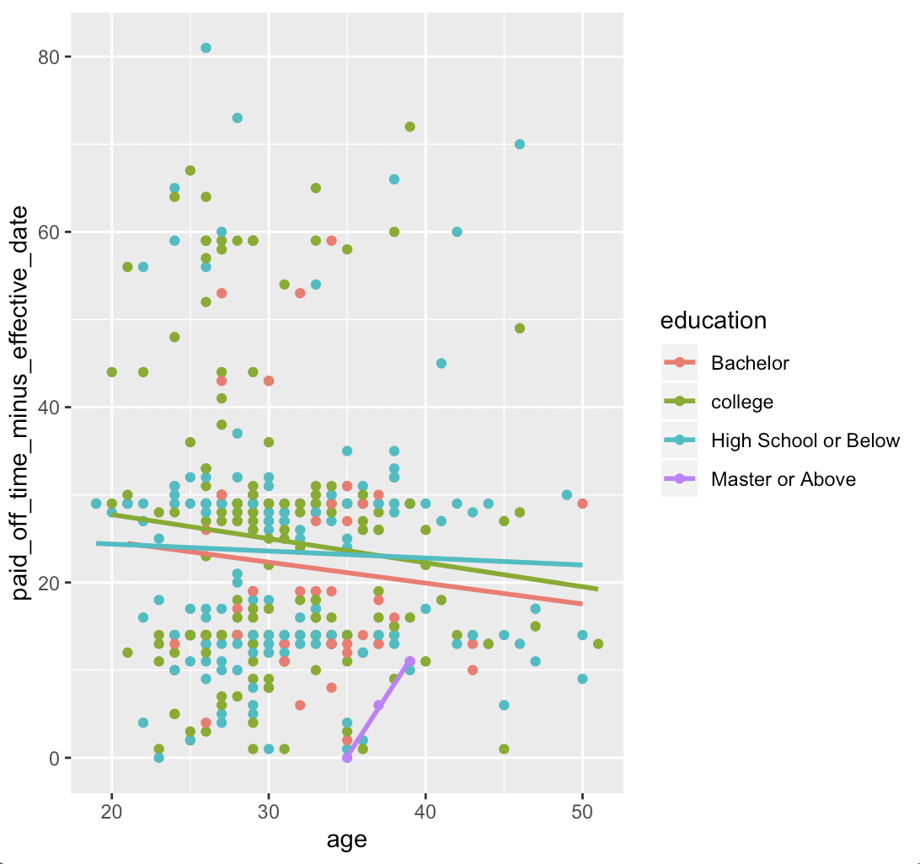
-Potential interaction terms for the model

Slide 6
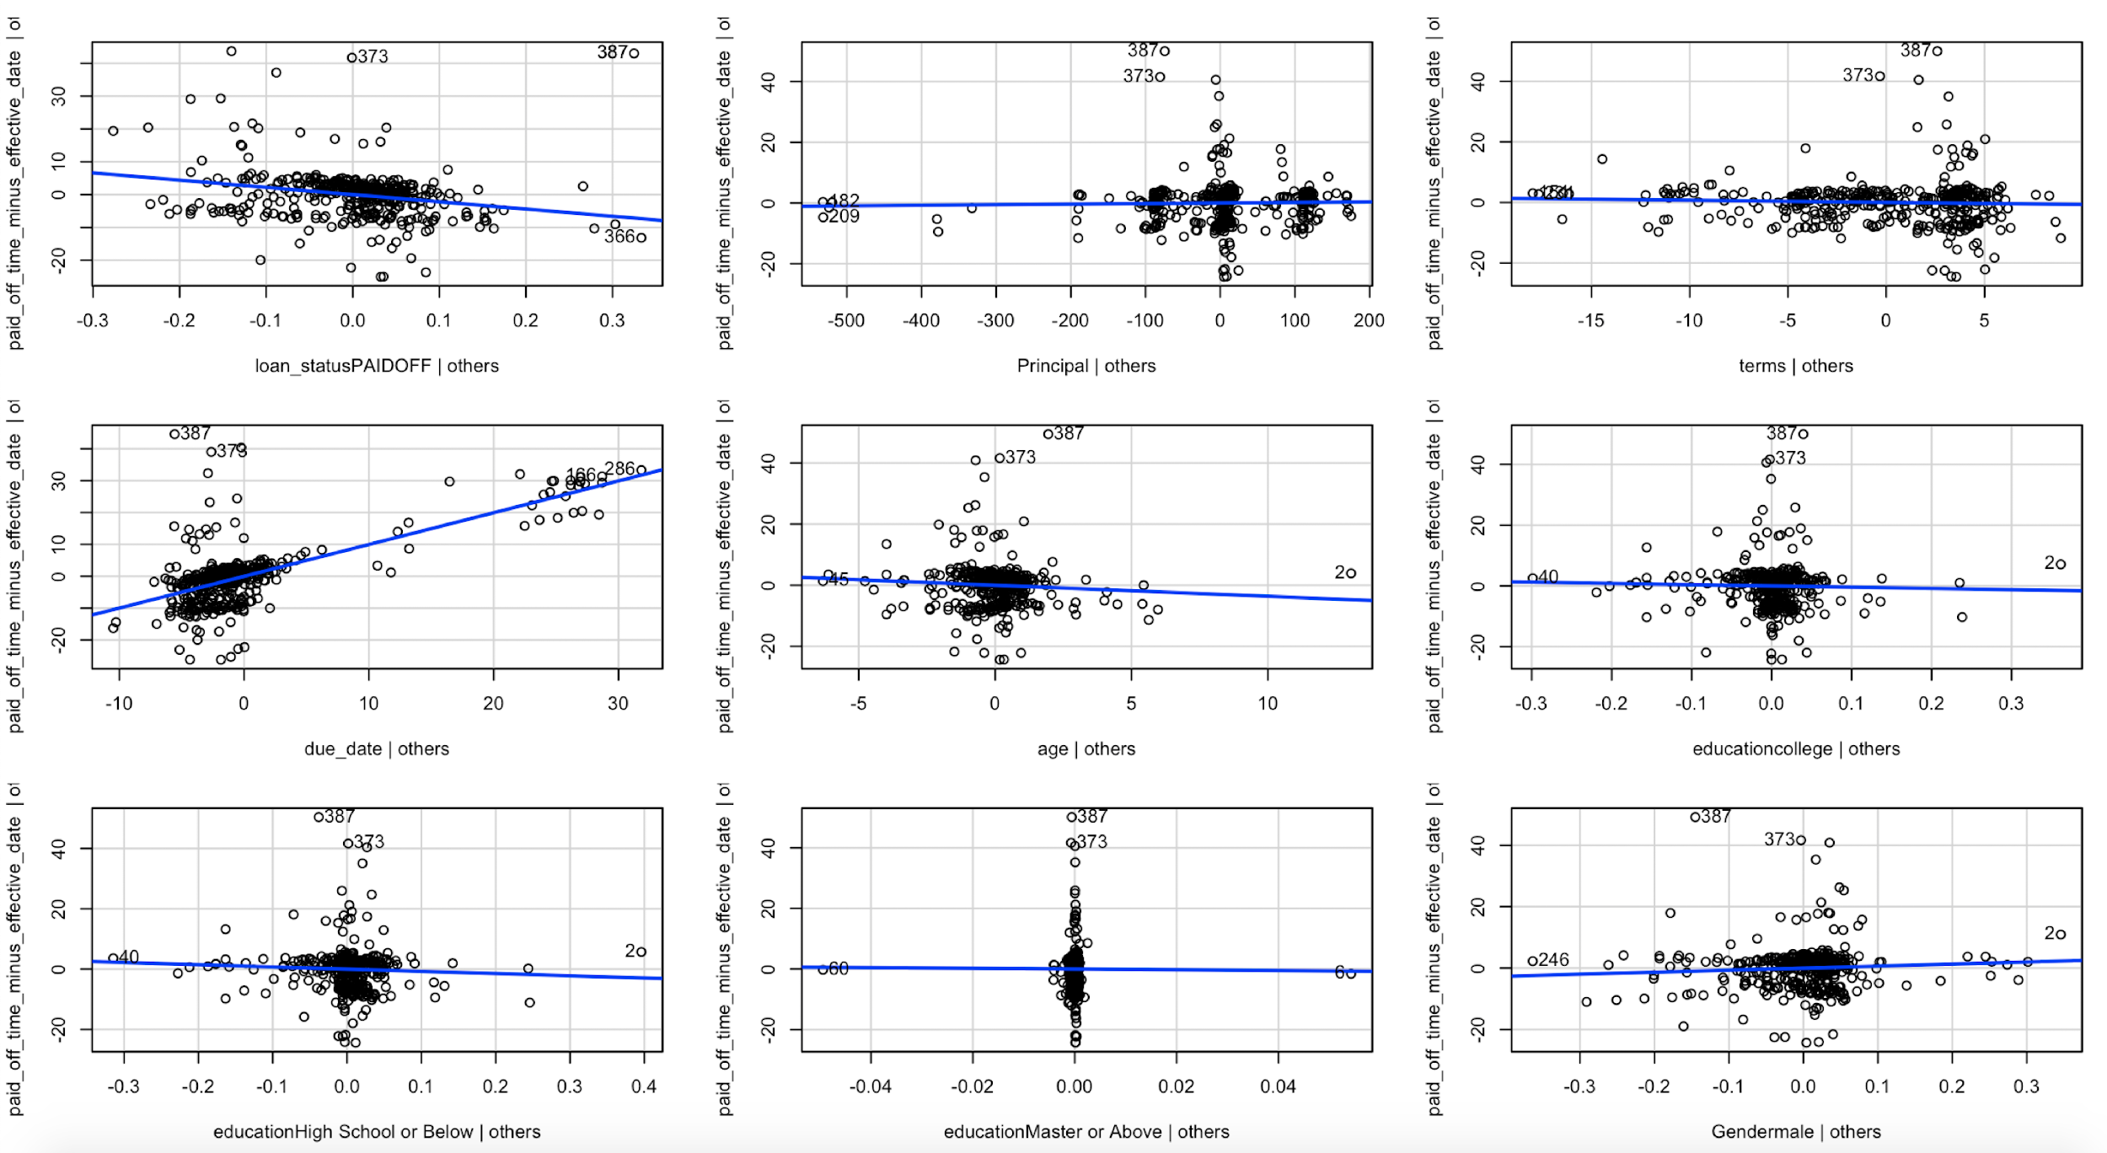
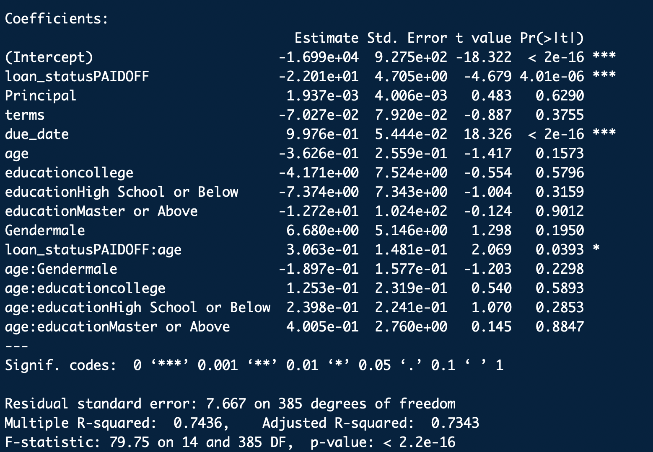
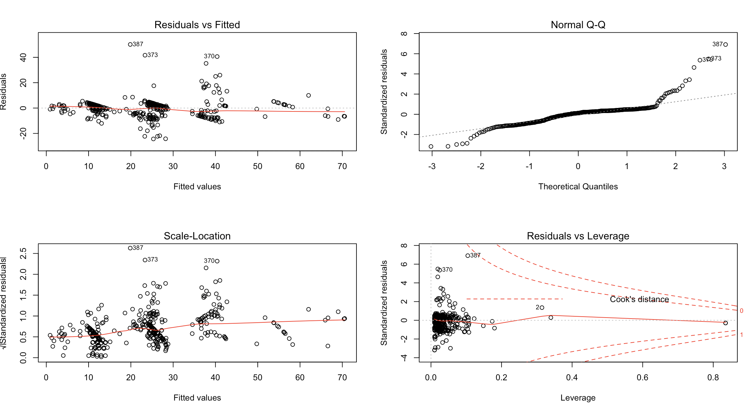
-From partial regression plots, no sign for higher order terms.
-From the residual plot we can see potential outliers and influential points.
-Constant variance assumption met (replications)
-Normality assumption is not valid

Slide 7
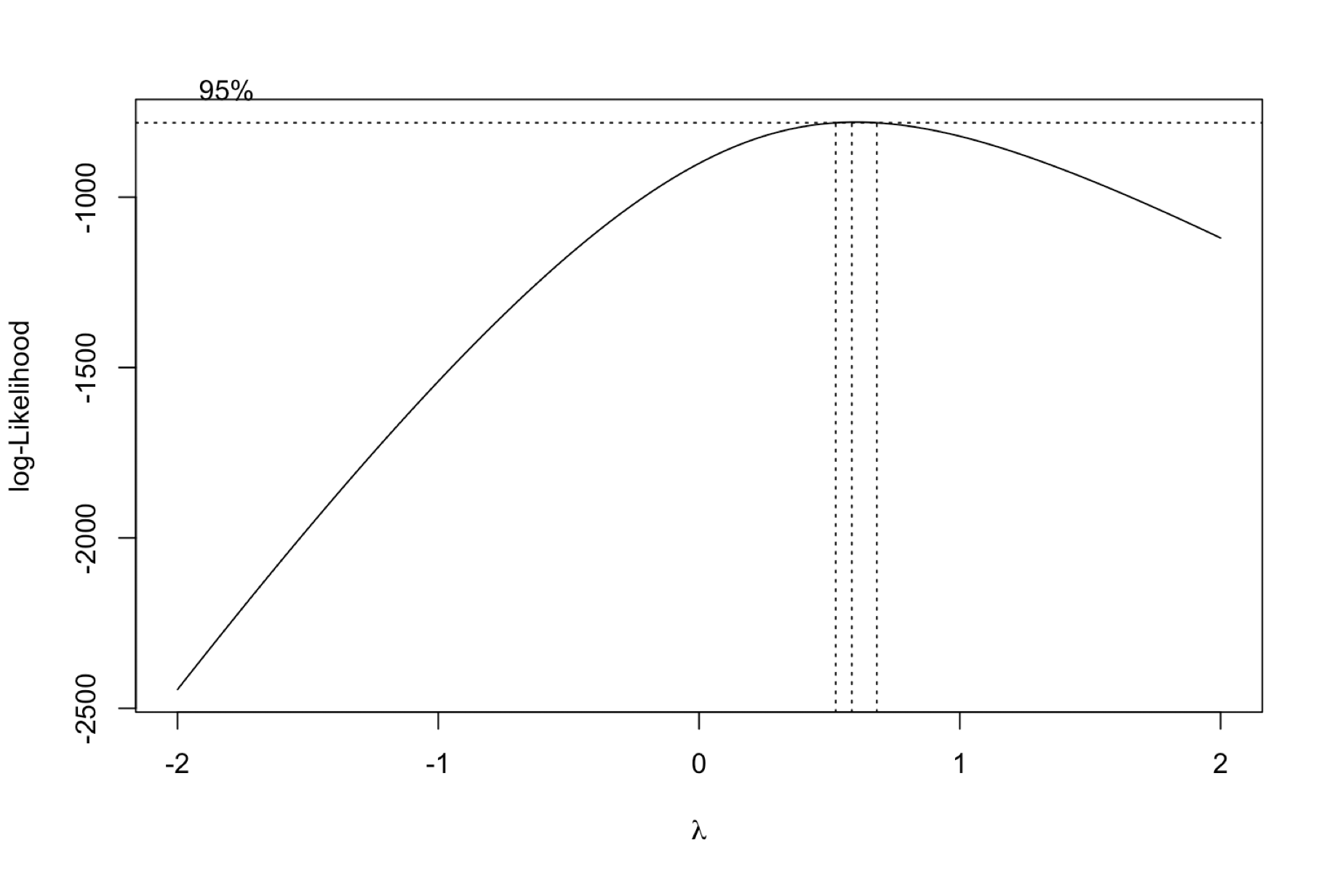
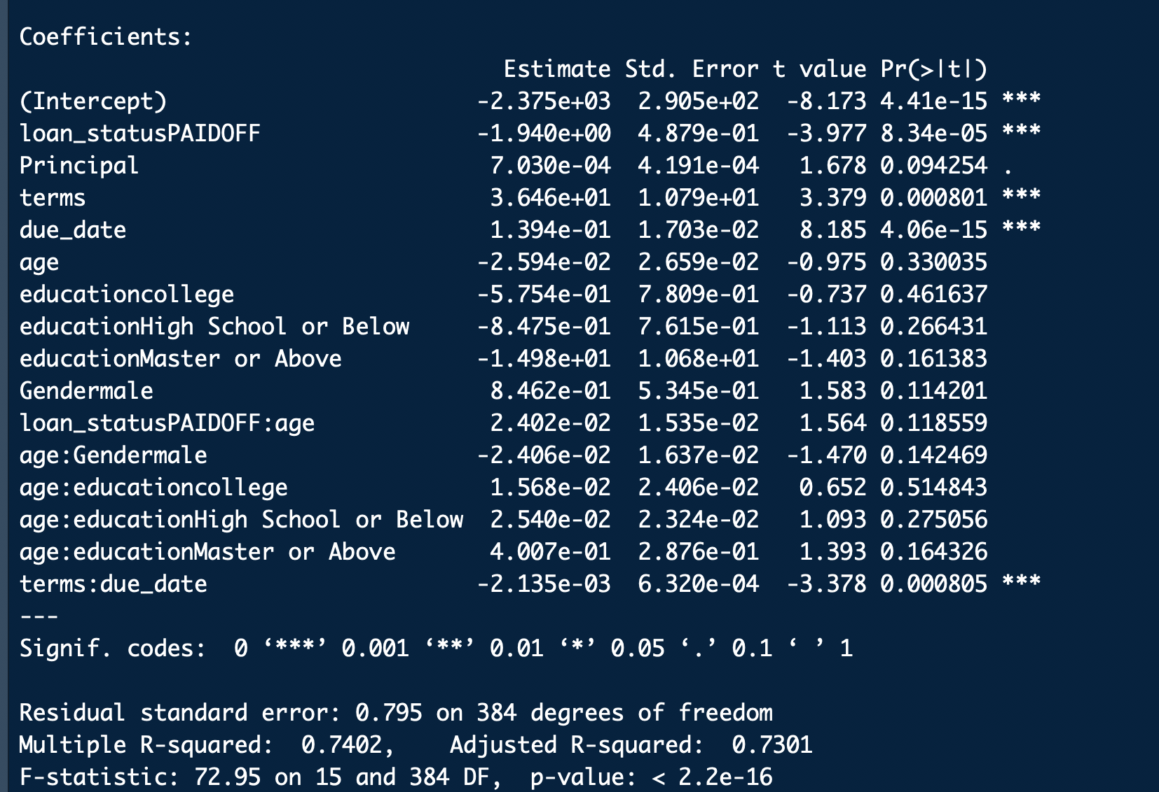
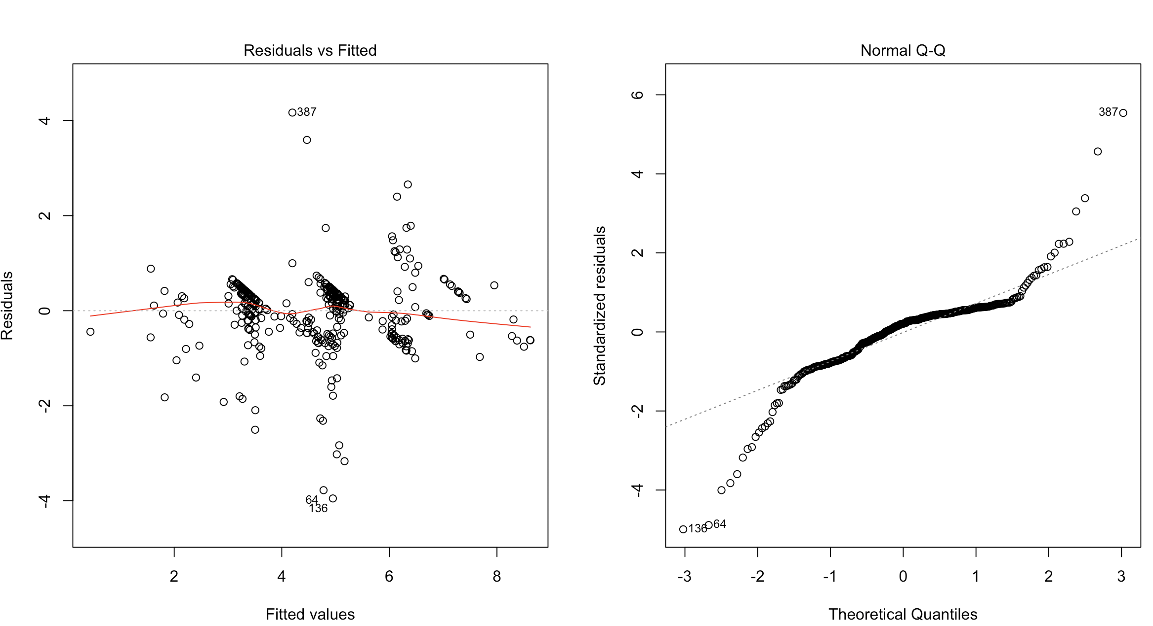
Box-Cox transformation:
-Use lambda value as 0.5, so apply sqrt transformation of response variable.
-Non-normality still exists.

Slide 8
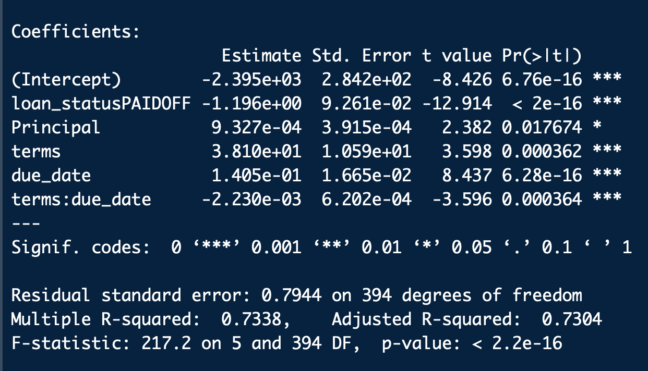
Variable Selection
Backward elimination:
Removed Age: education, education,
Age: Gender, Gender, Age: Loan status,
Age in that order.

Slide 9
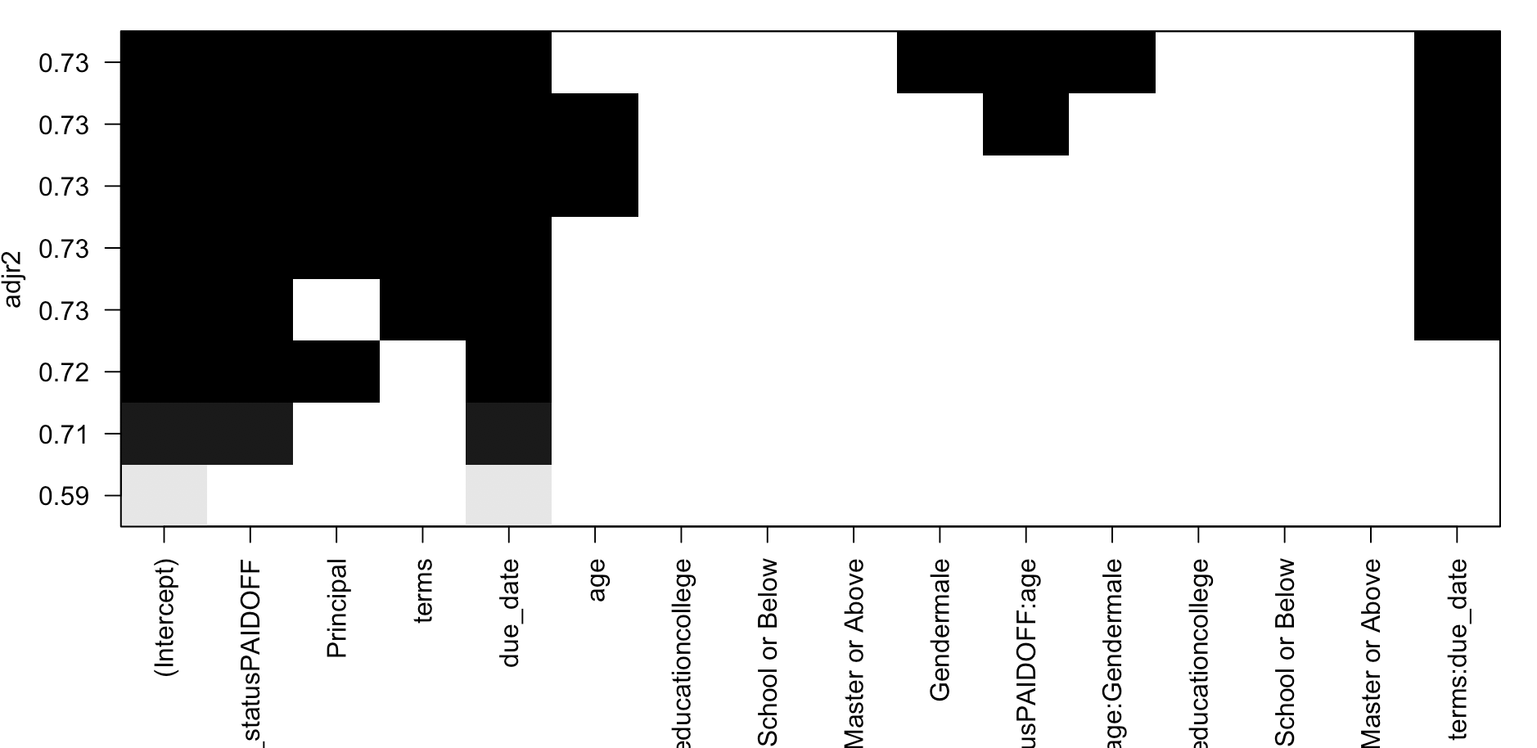
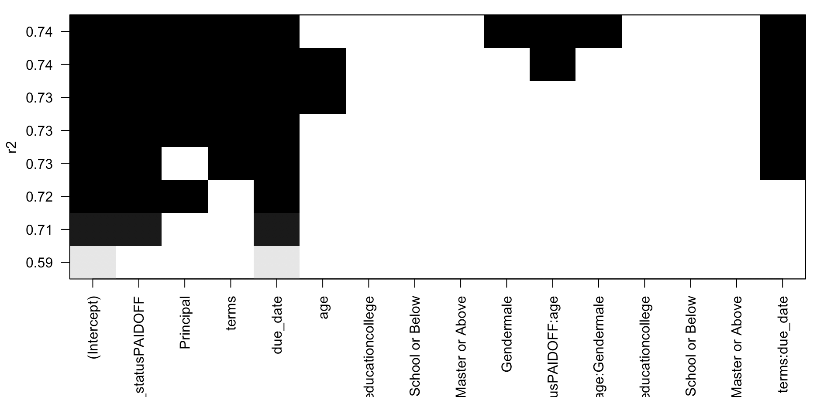
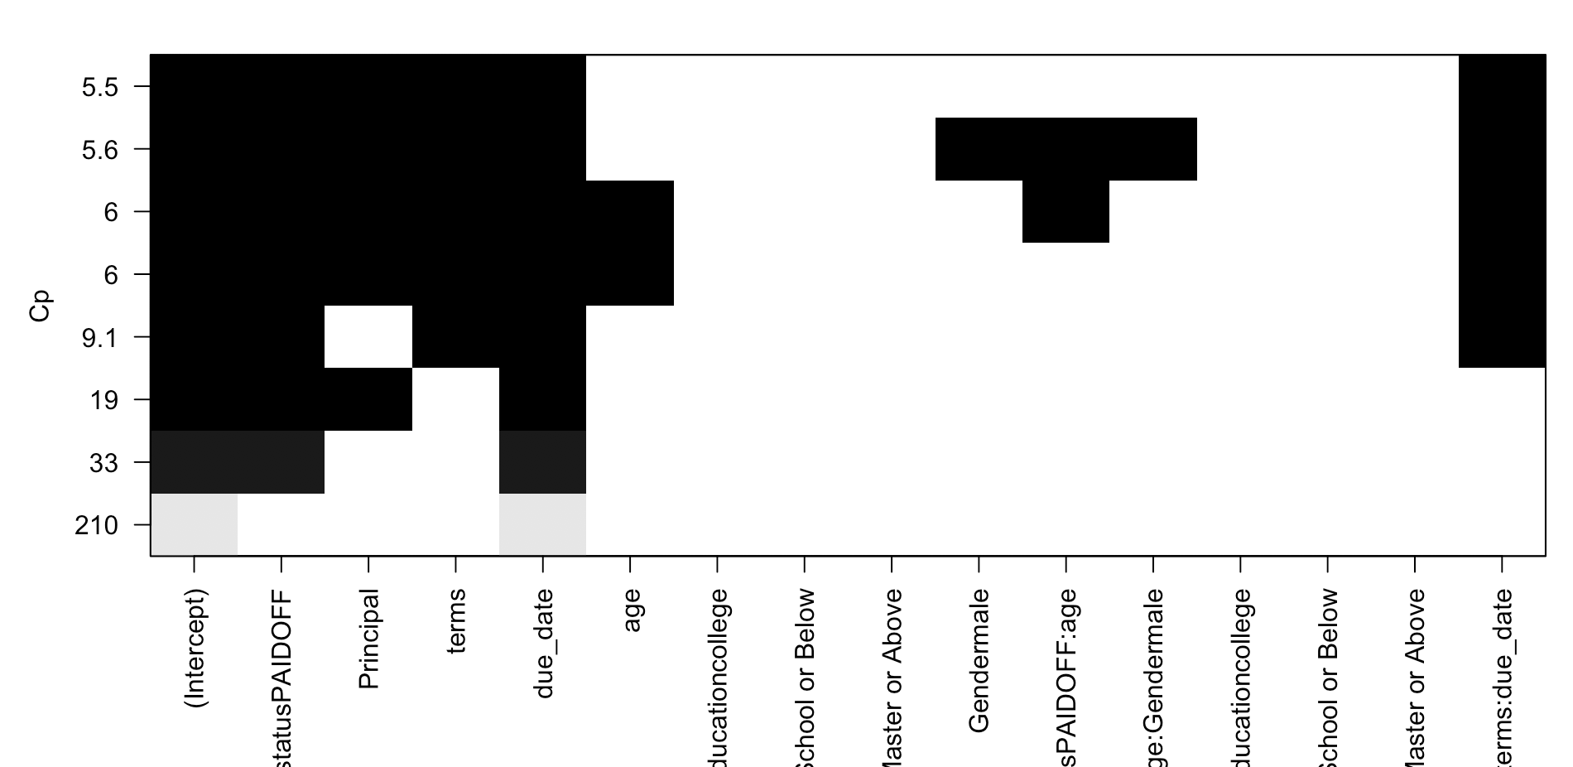
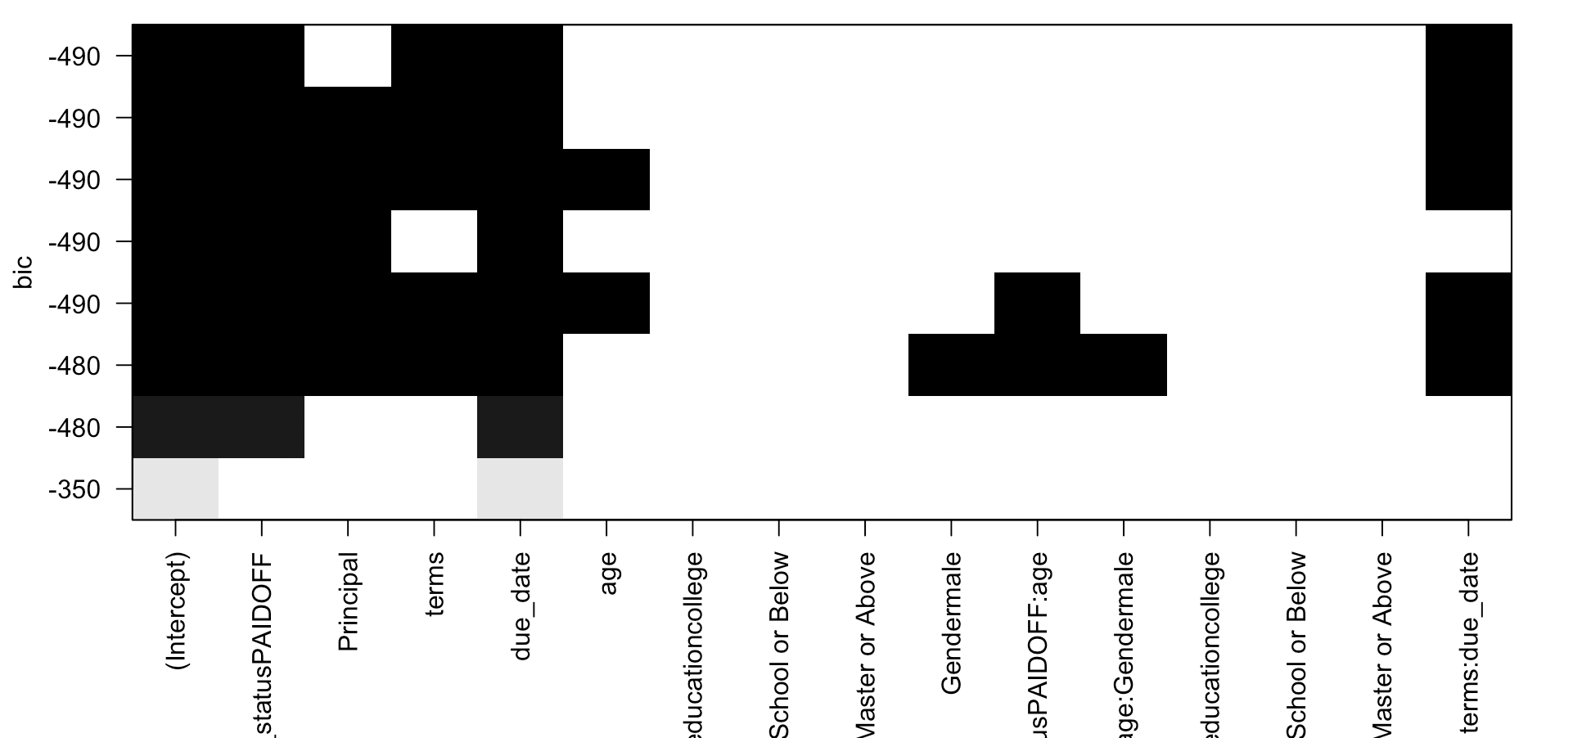
Using regsubsets: Loan status, Principal, Terms, Due Date, Terms: Due Date

Slide 10
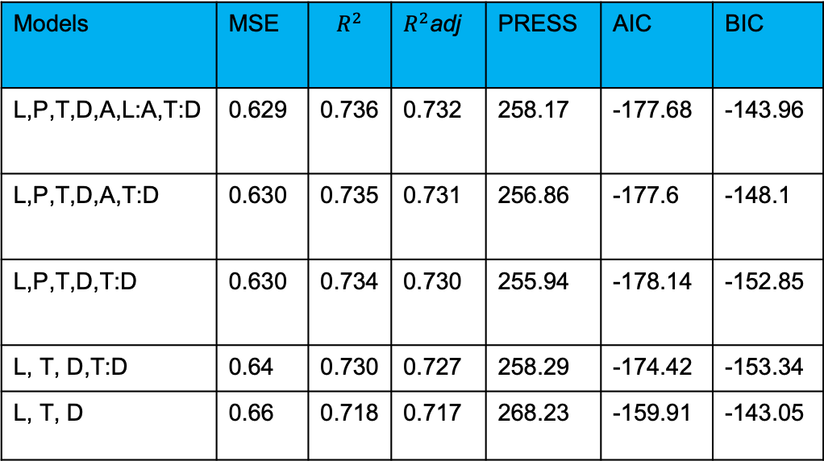
Continued:
L-loan status, P-Principal, T-terms, D-Due Date, A-age
Models | MSE | $$R^{2}$$ | $R^{2}$adj | PRESS | AIC | BIC
L,P,T,D,A,L:A,T:D | 0.629 | 0.736 | 0.732 | 258.17 | -177.68 | -143.96
L,P,T,D,A,T:D | 0.630 | 0.735 | 0.731 | 256.86 | -177.6 | -148.1
L,P,T,D,T:D | 0.630 | 0.734 | 0.730 | 255.94 | -178.14 | -152.85
L, T, D,T:D | 0.64 | 0.730 | 0.727 | 258.29 | -174.42 | -153.34
L, T, D | 0.66 | 0.718 | 0.717 | 268.23 | -159.91 | -143.05

Slide 11
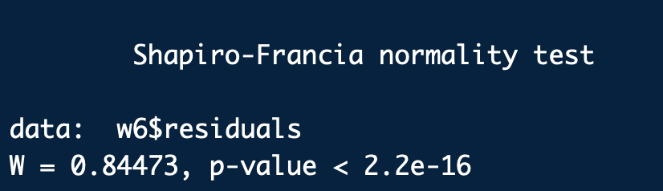
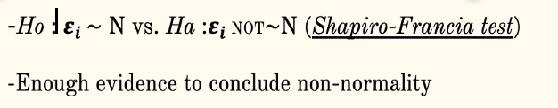
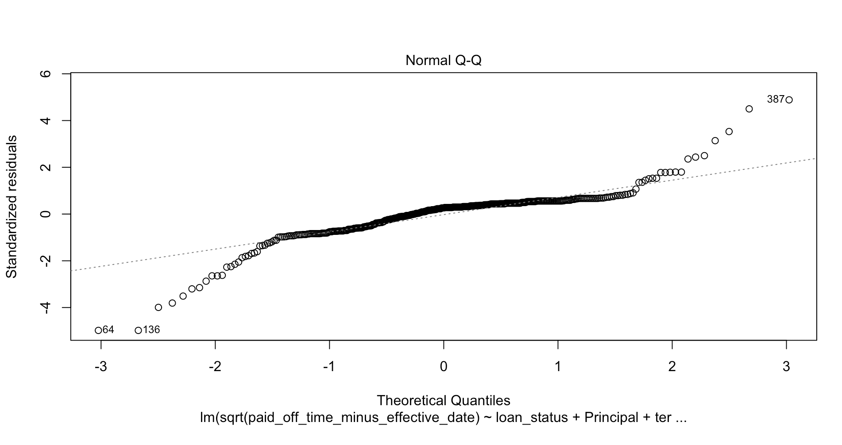
Model Diagnostics

Slide 12
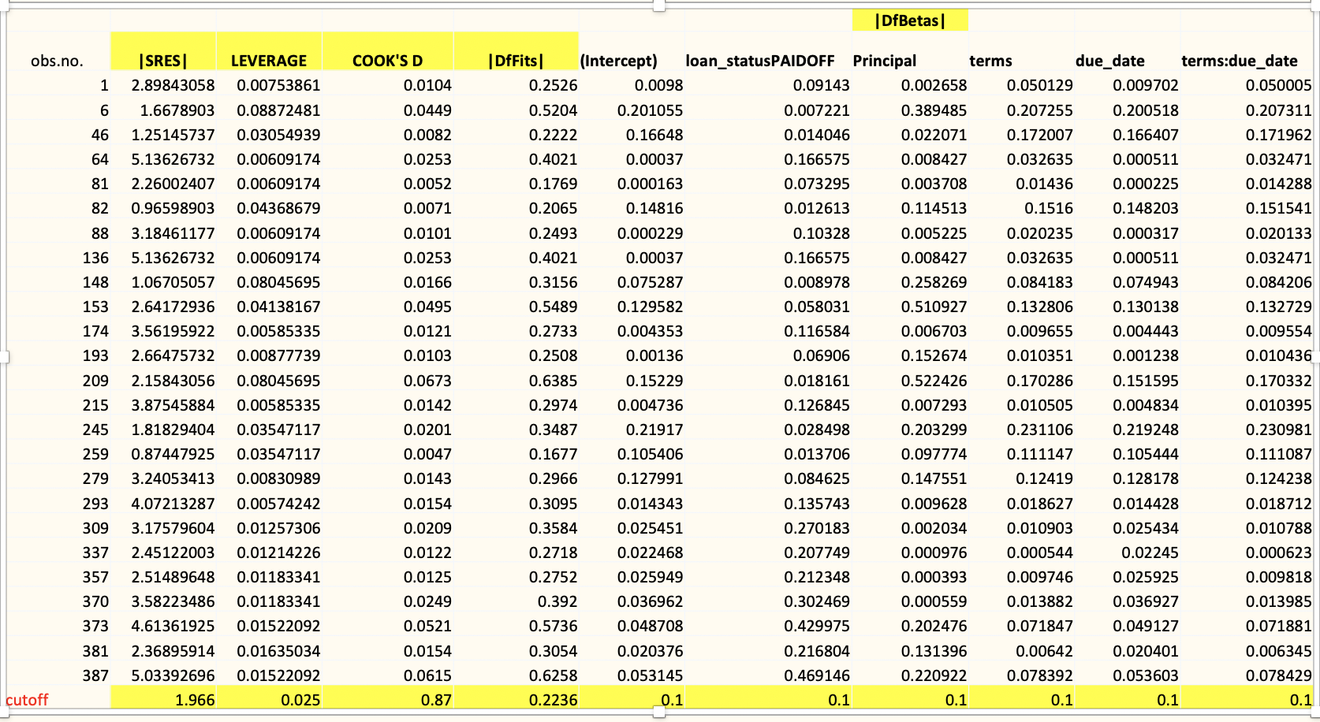
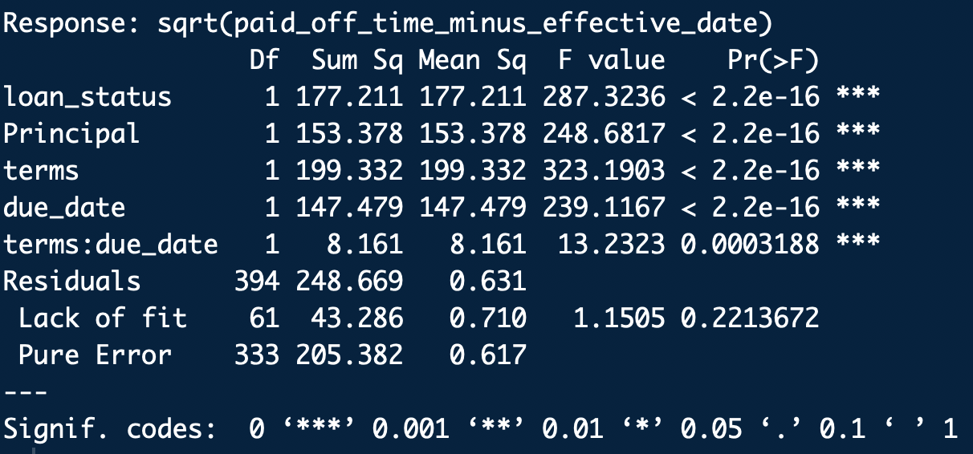
Lack of Fit Test:
Ho: Model ‘fits’
Ha: Model lacks fit
Not enough evidence to
conclude model lacks fit
/Or,Model is adequate.
Residual Diagnostics:

Slide 13
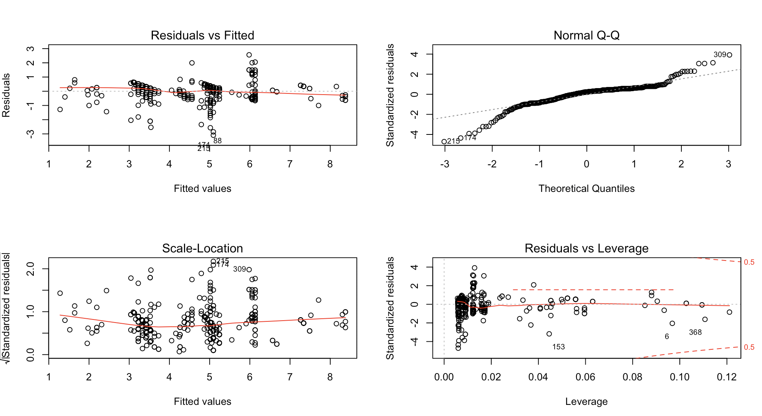
After removing outliers/
Influential observations one
by one, still Non-normality.
Solution: Robust Regression
-protect against non-normal
residuals by down-weighting
the outliers, not by excluding
them.
-used bisquare weighting.

Slide 14
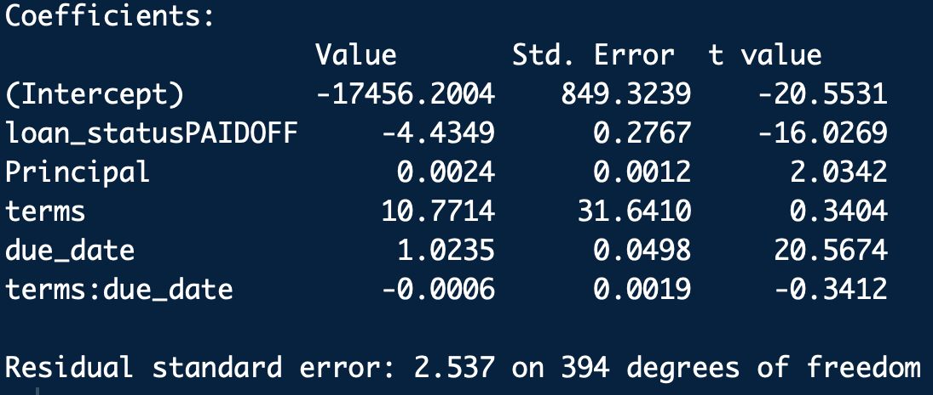
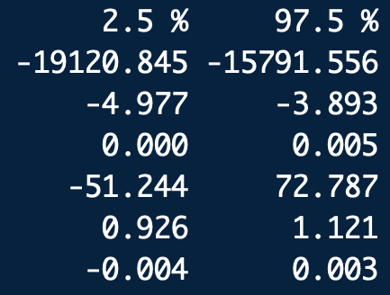
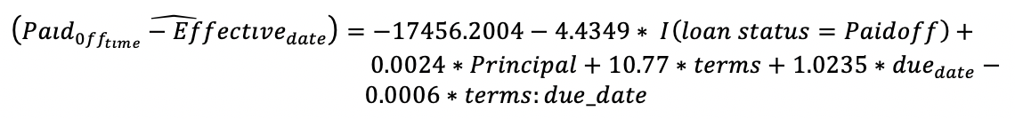
Robust regression:

Slide 15
Conclusion
Obviously, between paid off or collection-paid off, paid off loans are paid off earlier.
Holding everything constant, for every 1000 dollar increase in the principal, we would expect the length of the loan to increase by 2.4 days on average.
Interestingly there is an inverse relationship between term and the length of the loan. As term ⇧; the paid off-effective date (loan length) ⇩.

Slide 16
Logistic Regression: Data Preparation
Response variable: model whether a loan would be paid by the due date
loan_status_binary (1=paid off, 0= otherwise)
Predictors:
Age
Principal
Terms (7/15/30)
education (Bachelor/college/High School or Below/Master or Above)
gender (0/1)
Due_date
Effective_date
paid_off_time_minus_effective_date
paid_off_time_minus_effective_date.NA (missing value flag ) (0/1)

Slide 17
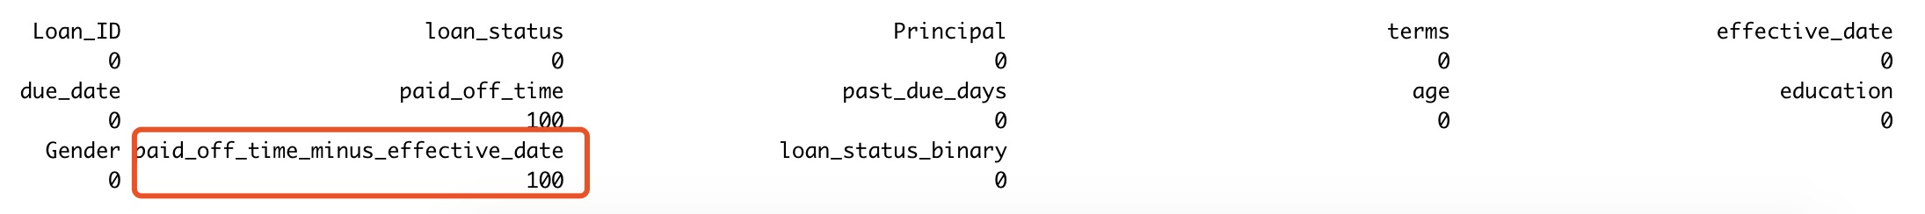
Checking Missing Values
Impute the missing values using the mean
Create missing value flag (paid_off_time_minus_effective_date.NA)

Slide 18
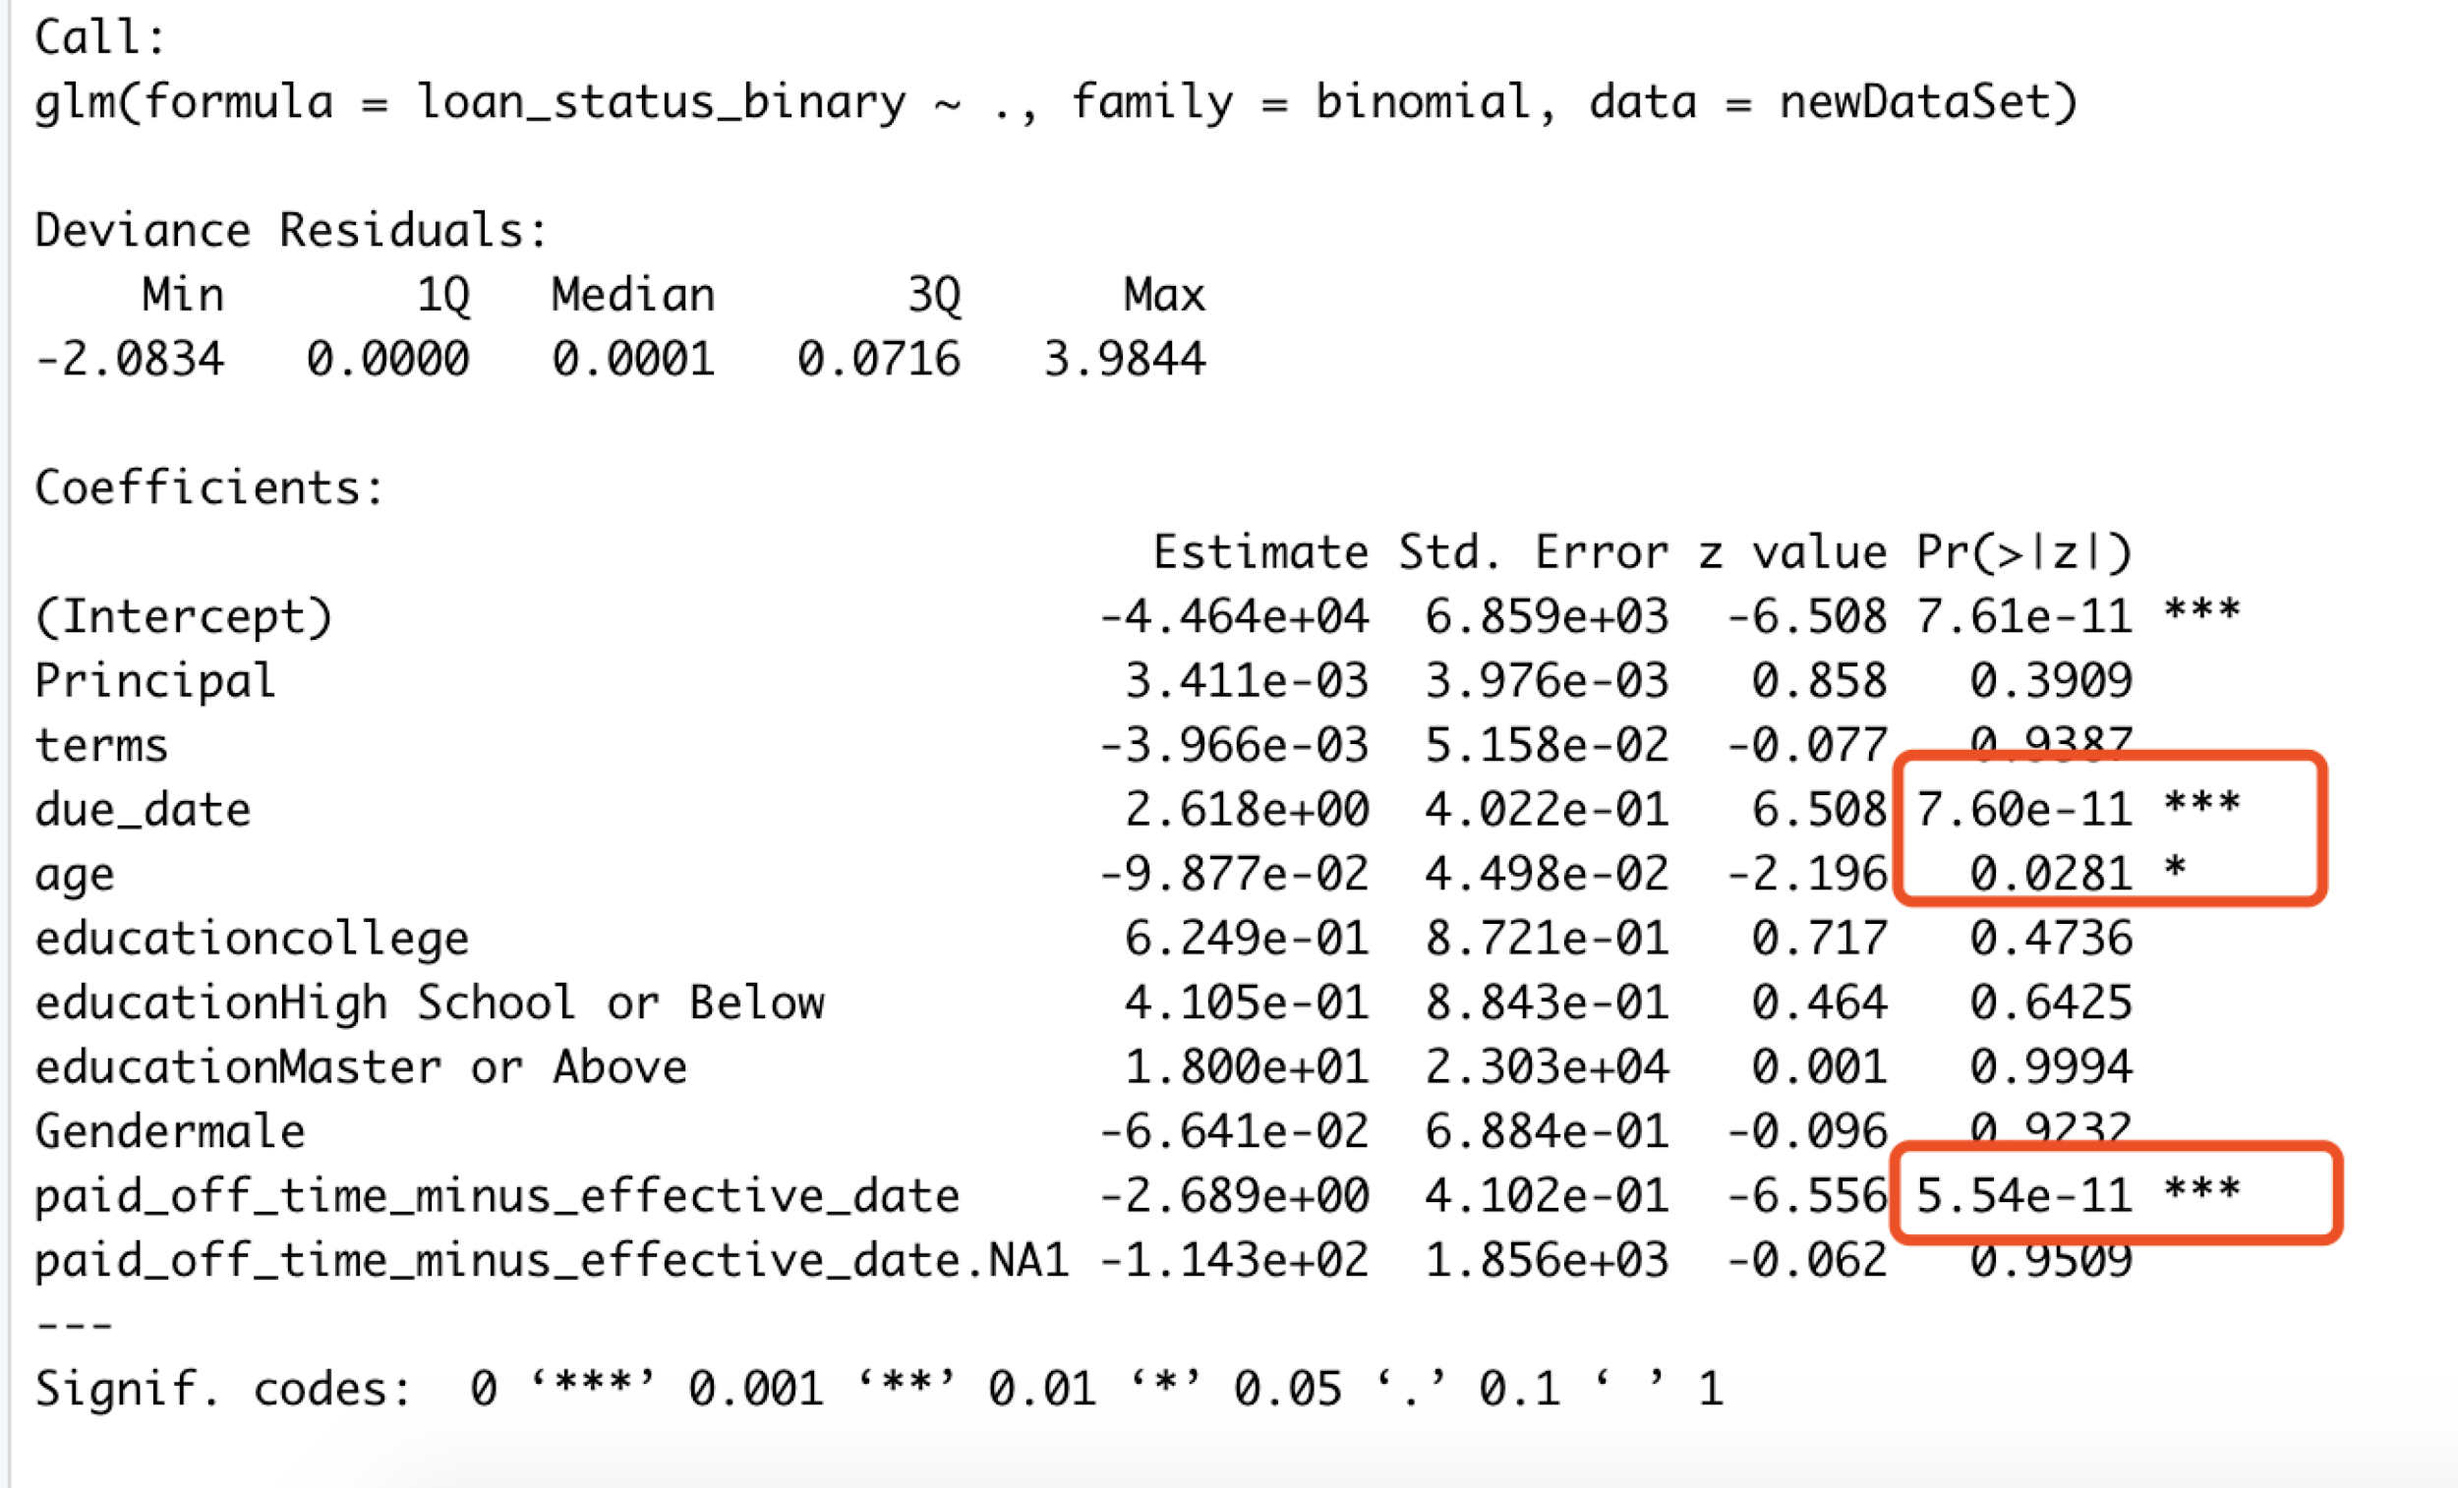
Model Formulation (Build full model)

Slide 19
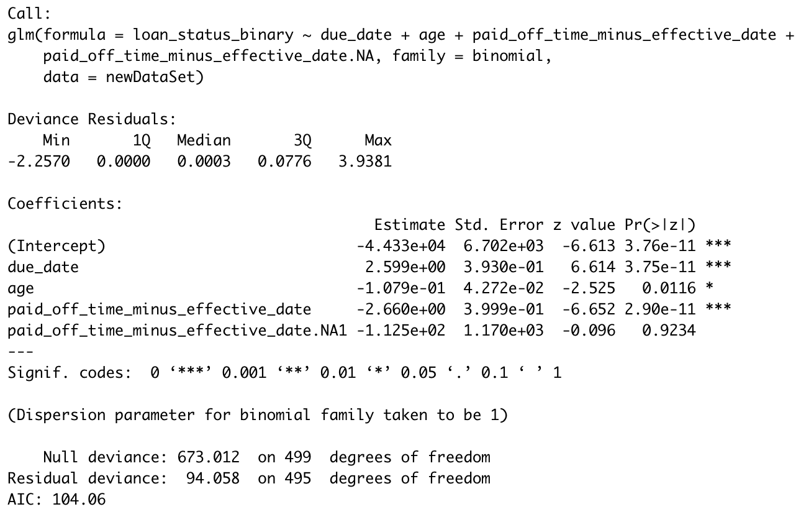
Backward selection Method

Slide 20
Inference In Logistic Regression
logit (π ̂(x)) = -44330 + 2.6X₁- 0.11X₂ - 2.66X₃ - 0.0113X₄
where, x1 = due_date; x2 = age; x3 = paid_off_time_minus_effective_date(loan length); x4 = paid_off_time_minus_effective_date
Likelihood ratio testing for the model significance
D = D_{null} − D_{residual} = 673-94.058
with corresponding p-value computed in R as 1−pchisq(578.95, 4) < 0.00001. we have enough evidence at 0.05 level to conclude that overall model is significant.

Slide 21
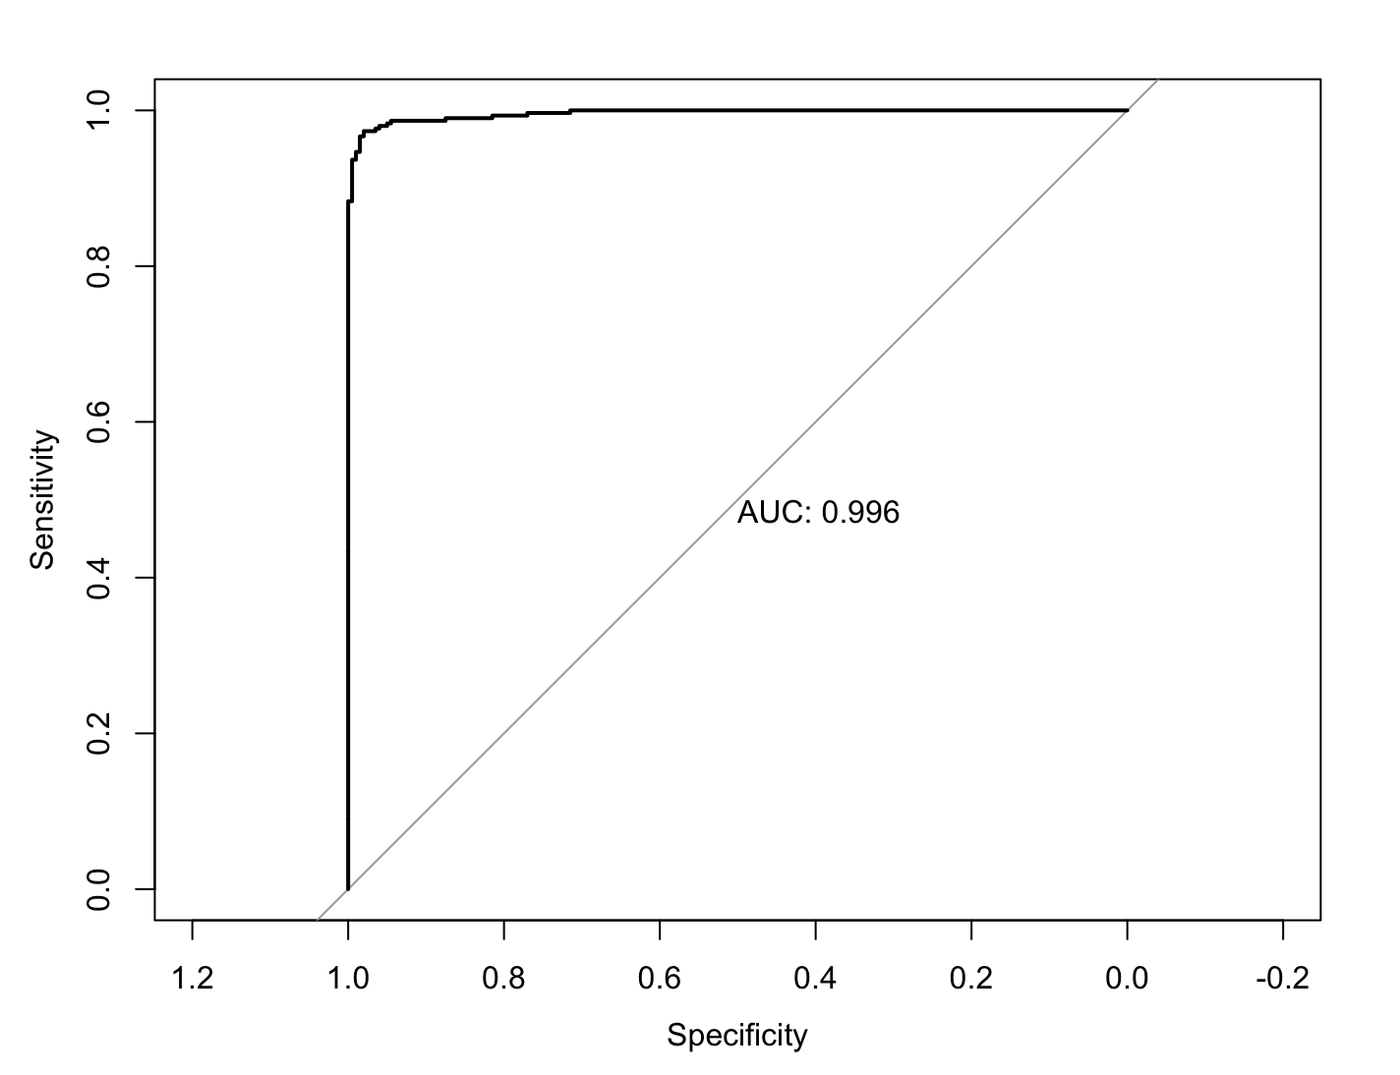
Roc Curve
AUC seems a bit too high
AUC is not a good metric for data with very unbalanced classes.
our samples possibly correlated
Since we are using our data to predict the outcomes of our data, this accuracy level is somewhat misleading and will tend to be optimistic. To avoid this, with a sufficient amount of data, we partition the data into a training set and a validation set. More details will be introduced in the data mining class.

Slide 22
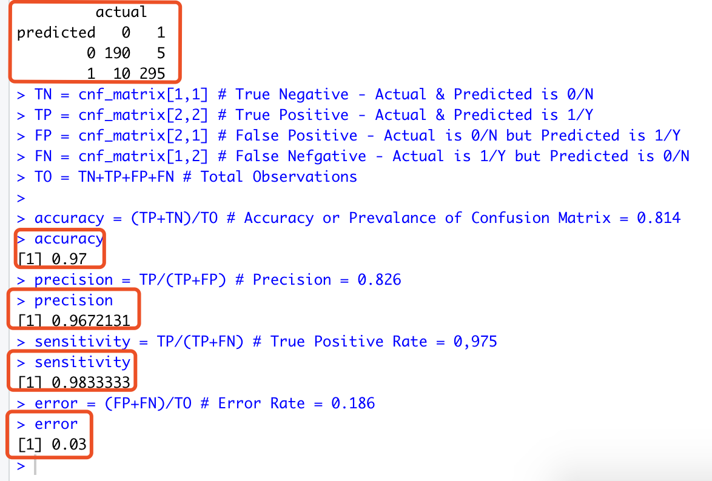
Accuracy Test
Accuracy = 0.97, our binary classification model predicted the outcome with 97% accuracy which is considered as good.
Precision=0.96, Logistic Regression model predicted loan will be approved 80% of the time.
Error Rate=0.03
Sensitivity=0.98
Our data seems to be unbalanced
we have 200 samples in class 0, 305 samples in class 1, so the AUROC should be significantly higher than 0.5.

Slide 23
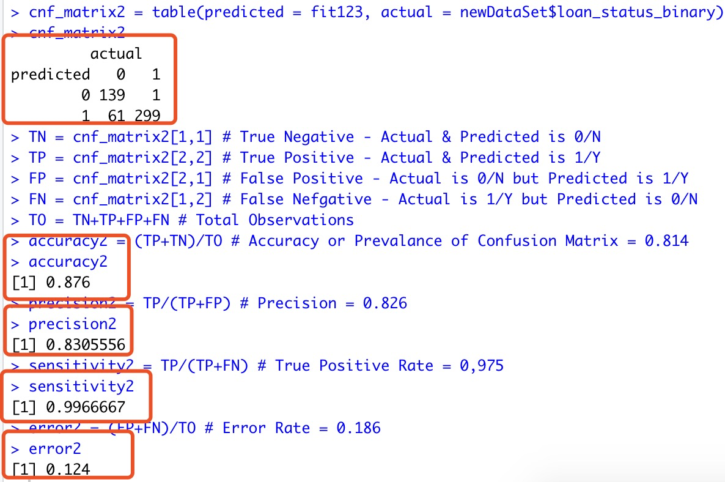
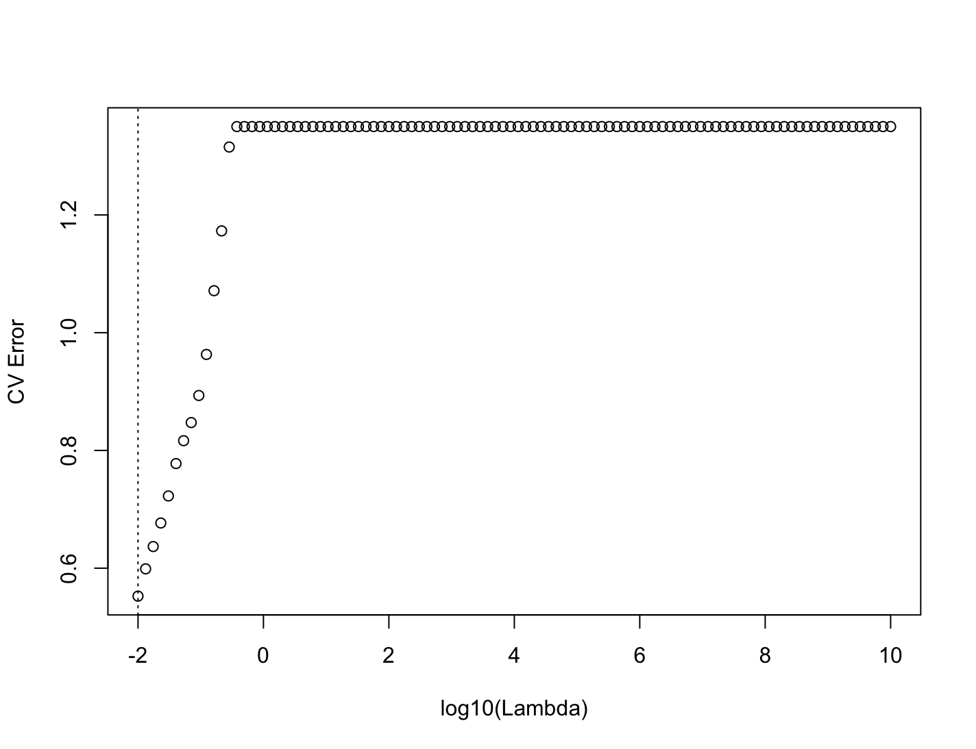
lasso regression (Penalized logistic regression)
The coefficients of some less contributive variables are forced to be exactly zero. Only the most significant variables are kept in the final model
The lambda that minimizes CV error: 0.01

Slide 24
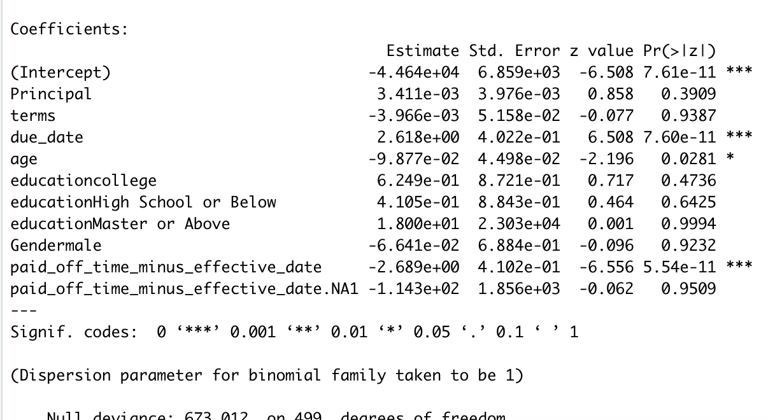
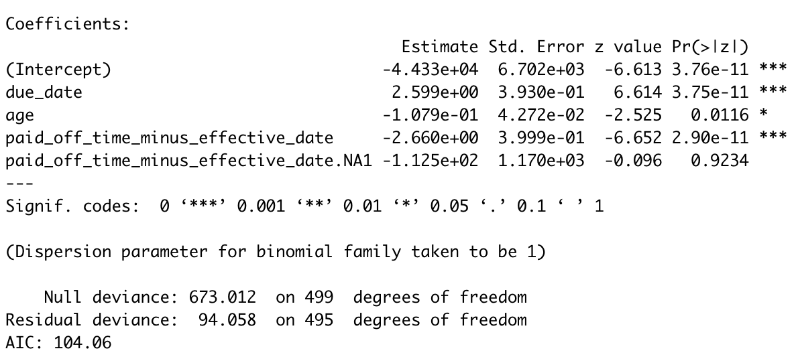
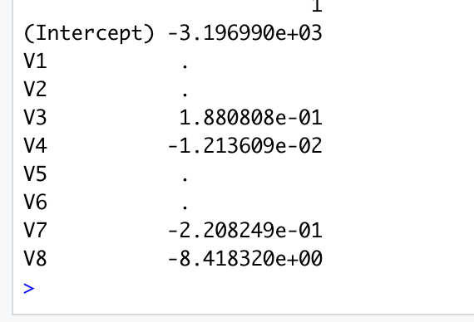
Compare
Logistic full model
Lasso regression model
StepAIC

Slide 25
Conclusion/ Limitations
due_date and loan length are the most important in determining if the loan will be approved.
We estimated that for each unit increase in X₁, the odds of loan(y=1) is multiplied by e^{2.6} = 13.6
We estimated that for each unit increase in X₃, the odds of loan(y=1) is multiplied by e^{-2.66} = 0.07
Missing values sometimes add more information to the model than we might expect
Imbalanced classification, to avoid this, with a sufficient amount of data, we partition the data into a training set and a validation set.
Notes:
Final Report has been updated regarding logistic regression.

